Slide 1
Data Mining Apriori Algorithm for Market Basket Analysis
MCS 5803 Project Presentation
Team members: Ashish Deriya, Urvashiben Thakkar, Yesha Patel

Slide 2
Contents
Introduction to Apriori
Frequent item sets
Apriori algorithm – The Theory
Support
Confidence
Flow chart
How does the Apriori Algorithm in Data Mining work?
Pros, and Cons
Applications
How to Improve the Efficiency of the Apriori Algorithm?
References

Slide 3
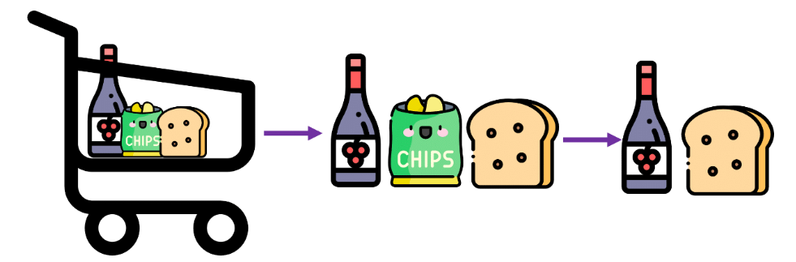
Introduction to APRIORI
Apriori algorithm is an influential algorithm that is generally used in the field of data mining & and association rule learning. It is used to identify frequent itemsets in a dataset & and generate an association-based rule based on the itemsets.
The name of the algorithm is Apriori because it uses prior knowledge of frequent itemset properties

Slide 4
Contd...
This small story will help you understand the concept better. You must have noticed that the local vegetable seller always bundles onions and potatoes together. He even offers a discount to people who buy these bundles.
Why does he do so? He realizes that people who buy potatoes also buy onions. Therefore, by bunching them together, he makes it easy for the customers. At the same time, he also increases his sales performance. It also allows him to offer discounts.
Similarly, you go to a supermarket, and you will find bread, butter, and jam bundled together. The idea is to make it comfortable for the customer to buy these three food items in the same place.
These three examples listed above are perfect examples of Association Rules in Data Mining. It helps us understand the concept of apriori algorithms.

Slide 5
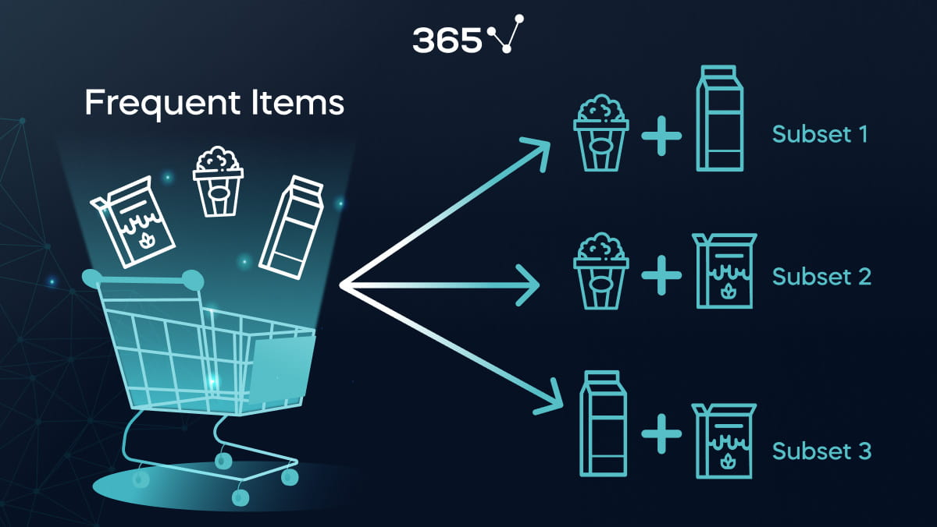
Frequent Item sets
Frequent item sets are sets of items that appear together frequently in a dataset.

Slide 6
Apriori algorithm – The Theory
Two significant components comprise the apriori algorithm. They
are as follows.
1. Support
2. Confidence
This example will make things easy to understand.
As mentioned earlier, you need a big database. Let us suppose you have 2000 customer transactions in a supermarket. You have to find the Support, Confidence for two items, say bread and jam. It is because people frequently bundle these two items together.
Out of the 2000 transactions, 200 contain jam whereas 300 contain bread. These 300 transactions include a 100 that includes bread as well as jam. Using this data, we shall find out the support, confidence.

Slide 7
Support
Support is the default popularity of any item. You calculate the Support as a quotient of the division of the number of transactions containing that item by the total number of transactions. Hence, in our example,
Support (Jam) = (Transactions involving jam) / (Total Transactions)
= 200/2000 = 10% contains Jam

Slide 8
Confidence
Confidence is the likelihood that customers bought both bread and jam. Dividing the number of transactions that include both bread and jam by the total number of transactions will give the Confidence figure.
Confidence = (Transactions involving both bread and jam) / (Total Transactions involving jam)
= 100/200 = 50%
It implies that 50% of customers who bought jam bought bread as well.

Slide 9
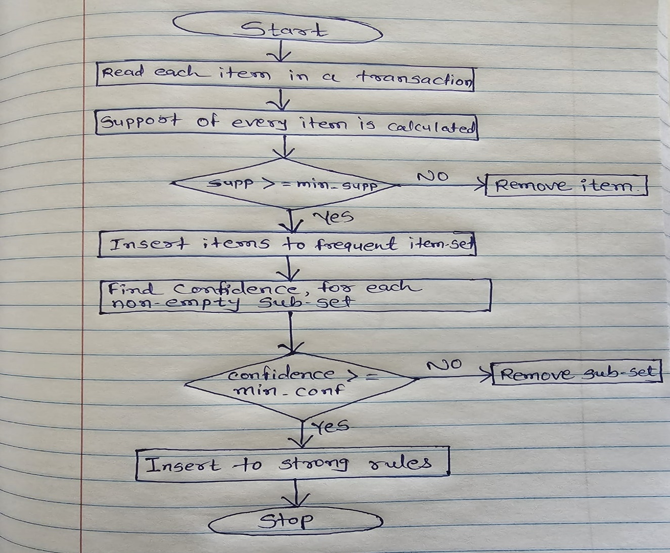
Flowchart of Apriori Algorithm

Slide 10
How this algorithm works in data mining?
TID | List of Items
T1 | Milk, coffee, chocolate, apple
T2 | Milk, coffee, sugar
T3 | Sugar, apple
T4 | Coffee, sugar
T5 | milk
T6 | Milk, coffee, sugar
Let’s understand the working of this algorithm with a simple example (Market- Basket Analysis).
Consider a supermarket scenario where the itemset is I = {Milk, Coffee, Sugar, Chocolate, Apple}. The database consists of six transactions.

Slide 11
Cont…
Firstly, Create a frequency table of all the items that occur in all the transactions.
Now, we must pick those items sets which frequency count is = 2 and > 2, because min_support_count = 2.
Item | Frequency | In transactions
Milk | 4 | T1, T2, T5, T6
Coffee | 4 | T1, T2, T4, T6
Sugar | 4 | T2, T3, T4, T6
Chocolate | 1 | T1
Apple | 2 | T1, T3
Item | Frequency | In transactions
Milk | 4 | T1, T2, T5, T6
Coffee | 4 | T1, T2, T4, T6
Sugar | 4 | T2, T3, T4, T6
Apple | 2 | T1, T3

Slide 12
Cont…
Now, we make 2-item set together.
Now, we must pick those items sets which frequency count is = 2 and > 2, because min_support_count = 2.
2- Item sets | Frequency | In transactions
Milk, coffee | 3 | T1, T2, T6
Milk, sugar | 2 | T2, T6
Milk, apple | 1 | T1
Coffee, sugar | 3 | T2, T4, T6
Coffee, apple | 1 | T1
Sugar, apple | 1 | T3
Item | Frequency | In transactions
Milk, coffee | 3 | T1, T2, T6
Milk, sugar | 2 | T2, T6
Coffee, sugar | 3 | T2, T4, T6
Now, we have three items only milk, coffee, sugar

Slide 13
Cont…
Now, we make 3-item set together.
Item | Frequency
Milk | 4
Coffee | 4
Sugar | 4
Milk, coffee | 3
Milk, Sugar | 2
Coffee, sugar | 3
3- Item sets | Frequency | In transactions
Milk, coffee, sugar | 2 | T2, T6
Non-empty subsets of {Milk, Coffee, Sugar}:
{Milk},
{Coffee},
{Sugar},
{Milk, Coffee},
{Milk, Sugar},
{Coffee, Sugar}

Slide 14
Cont…
Now, we calculate confidence for association rule.
Support of {milk, coffee, sugar} = 2/6
Rule 1: {Milk} --> {Coffee, Sugar}
Support of (Milk) is 4/6.
Confidence = support (milk, coffee, sugar) / support (milk) = 2/6 / 4/6 = 2/4*100 = 50% (50% < 60%)
Rule 2: {Coffee} --> {Milk, Sugar}
Support of (coffee) is 4/6.
Confidence = support (milk, coffee, sugar) / support (coffee) = 2/6 / 4/6 = 2/4*100 = 50% (50% < 60%)
Rule 3: {Sugar} --> {Milk, Coffee}
Support of (sugar) is 4/6.
Confidence = support (milk, coffee, sugar) / support (sugar) = 2/6 / 4/6 = 2/4*100 = 50% (50% < 60%)

Slide 15
Cont…
Rule 4: {Milk, coffee} --> {Sugar}
Support of (Milk, coffee) is 3/6.
Confidence = support (milk, coffee, sugar) / support (Milk, coffee) = 2/6 / 3/6 = 2/4*100 = 66.67%
(66.67% > 60%)
Rule 5: {Milk, sugar} --> {coffee}
Support of (Milk, sugar) is 2/6.
Confidence = support (milk, coffee, sugar) / support (Milk, sugar) = 2/6 / 2/6 = 2/4*100 = 100%
(100% > 60%)
Rule 6: {coffee, sugar} --> {milk}
Support of (coffee, sugar) is 3/6.
Confidence = support (milk, coffee, sugar) / support (coffee, sugar) = 2/6 / 3/6 = 2/4*100 = 66.67%
(100% > 60%)
So, from this calculation, strongly associated rules are: {Milk, coffee} --> {Sugar}, {Milk, sugar} --> {coffee}
{coffee, sugar} --> {milk}

Slide 16
What are the advantages of Apriori Algorithm in data mining?
Simplicity & ease of implementation
The rules are easy to human-readable * interpretable
Works well without labeled data
Flexibility & customizability
Extensions for multiple use cases can be created easily
The algorithm is widely used & studied

Slide 17
What are the disadvantages of Apriori Algorithm in data mining?
Computational complexity
Time & space overhead
Difficulty handling sparse data
Limited discovery of complex patterns
Higher memory usage
Bias of minimum support threshold
Inability to handle numeric data
Lack of incorporation of context

Slide 18
How can we improve the Apriori Algorithm's efficiency?
Here are some of the methods to improve the efficiency of apriori algorithm –
Hash-Based Technique: This method uses a hash-based structure called a hash table for generating the k-itemsets and their corresponding count. It uses a hash function for generating the table.
Transaction Reduction: This method reduces the number of transactions scanned in iterations. The transactions which do not contain frequent items are marked or removed.
Partitioning: This method requires only two database scans to mine the frequent itemsets. It says that for any itemset to be potentially frequent in the database, it should be frequent in at least one of the partitions of the database.
Sampling: This method picks a random sample S from Database D and then searches for frequent itemset in S. It may be possible to lose a global frequent itemset. This can be reduced by lowering the min_sup.
Dynamic Itemset Counting: This technique can add new candidate itemsets at any marked start point of the database during the scanning of the database.

Slide 19
What are the applications of Apriori Algorithm in data mining?
The Apriori Algorithm has picked up a pace in recent years and is used in different industries for data mining and handling.
Some fields where Apriori is used:
1. Medical
Hospitals are generally trashed with data every day and need to retrieve a lot of past data for existing patients. The Apriori algorithm helps hospitals to manage the database of patients without jinxing it with other patients.
2. Education
The educational institute can use the Apriori algorithm to store and monitor students’ data like age, gender, traits, characteristics, parent’s details, etc.
3. Forestry
On the same line as the education and medical industry, forestry can also use the Apriori algorithm to store, analyze, and manage details of every flora and fauna of the given territory.

Slide 20
4. New Tech Firms
Tech firms use the Apriori algorithm to maintain the record of various items of products that are purchased by various customers for recommender systems.
5. Mobile Commerce
Big data can help mobile e-commerce companies to deliver an easy, convenient, and personalized shopping experience. With the Apriori algorithm, the real-time product recommendation accuracy increases, which creates an excellent customer experience and increases sales for the company.

Slide 21
References:
Apriori Algorithms and Their Importance
(digitalvidya.com)
in Data Mining
Flow chart of Apriori-algorithm | Download Scientific Diagram (researchgate.net)
What is the Apriori algorithm? (educative.io)
Apriori Algorithm – GeeksforGeeks
Niu, K., Jiao, H., Gao, Z., Chen, C., & Zhang, H. (2017). A developed apriori algorithm based on frequent matrix. Proceedings of the 5th International Conference on Bioinformatics and Computational Biology - ICBCB ’17. doi:10.1145/3035012.3035019
Fast Algorithms for Mining Association Rules (vldb.org)
Apriori Association Rules | Grocery Store | Kaggle
Implementing Apriori algorithm in Python - GeeksforGeeks

